Slide 1
DIGITAL CLOCK
BY:P.DURGA DEVI

Slide 2

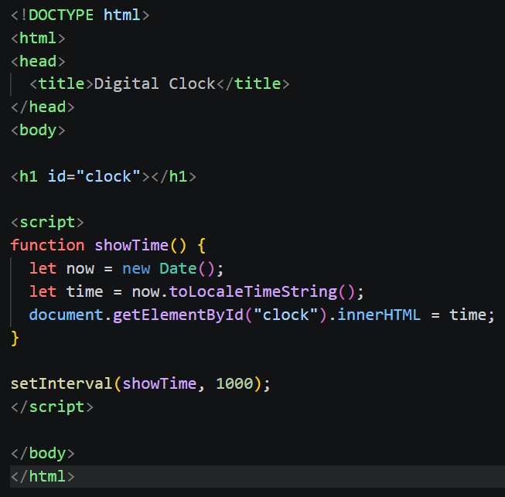
CODE

Slide 3
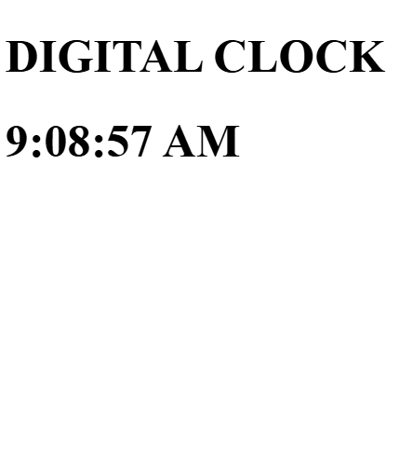
OUTPUT

Slide 4

THANK YOU

